Slide 1










ST. XAVIER’S COLLEGE (AUTONOMOUS), KOLKATA
DEPARTMENT OF STATISTICS
DISSERTATION PROJECT
NAME : ARIJIT DAS
CIN ID : 22-300-4-07-0410
SUPERVISOR : DR. DURBA BHATTACHARYA
SESSION : 2022-2025

Slide 2

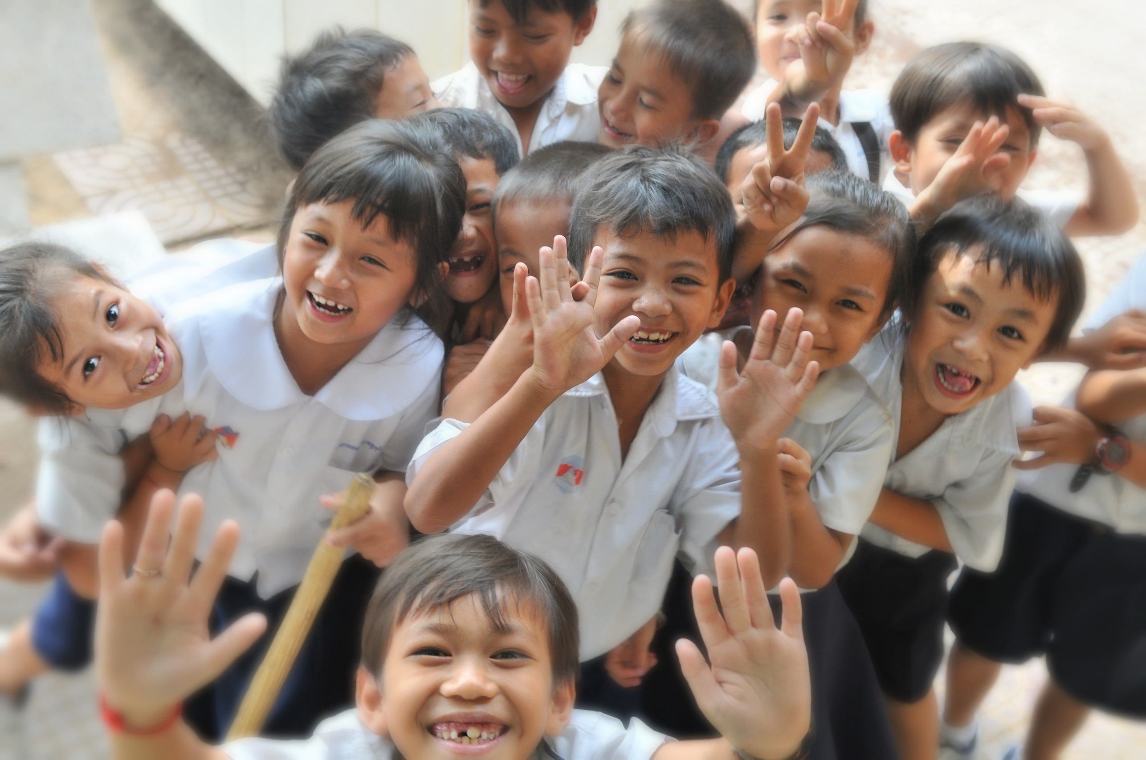

A STUDY ON ENROLMENTS IN SCHOOL EDUCATION SYSTEM OF INDIA OVER THE YEARS 2018 - 2023
Unfolding India's Classrooms

Slide 3




OBJECTIVES
01
02
03
04
To examine trends in school enrolments, dropout rates, and pupil-teacher ratios (PTR) across different education levels in India between 2018 and 2023.
To compare gender-wise differences in dropout rates and assess their statistical significance.
To perform graphical and statistical analysis of primary enrolments based on school management type (government vs private).
To apply multiple regression to identify how factors like population, unemployment, dropout rates, and PTR influence state-level school enrolments.

Slide 4




contents
1.
Introduction
2.
Primary Level : Govt or Private?
3.
Dropout trends
Regression Analysis of School enrolments for the year 2023
4.
5.
Pupil Teacher Ratio
6.
Conclusion

Slide 5
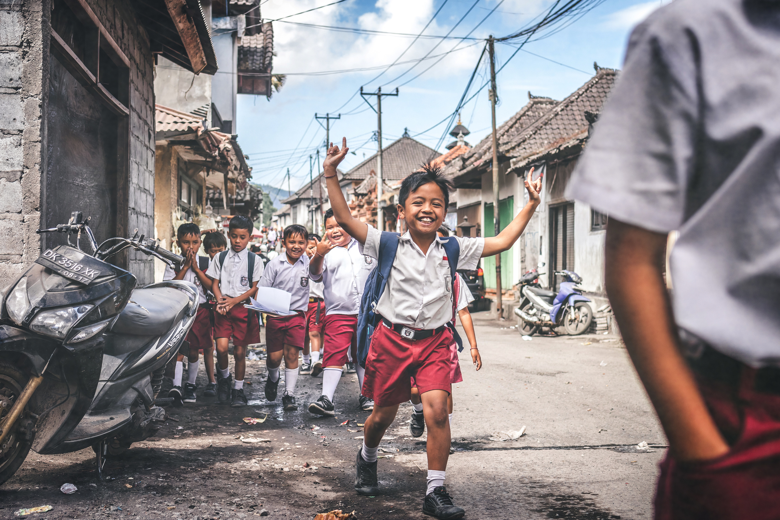
1. introduction
Education is central to national development, and the quality and accessibility of school education directly influence a country’s socio-economic progress. Despite recent reforms, challenges like high dropout rates, uneven pupil-teacher ratios (PTR), and gender disparities continue in India. To address these, it is essential to analyze school-level data statistically.
This dissertation uses UDISE+ data from 2018 to 2023 to examine trends in enrolment, dropouts, and PTR across gender, school levels, and regions. The goal is to generate data-driven insights that can support evidence-based educational planning and policy decisions.

Slide 6



I have collected the data from the following Websites:
UDISE+
UIDAI
STUDY IQ
WIKIPEDIA
data collection & description
Several datasets have been used for the study.
1. Enrolments dataset consists of 6 columns and 225 rows
2. Dropout Rate dataset consists of 11 columns and 224 rows. Dropout Rate of Ladakh for the Year 2018 is missing in the dataset.
3. Pupil-Teacher Ratio dataset consists of 6 columns and 225 rows
4. 2023 dataset containing enrolments, population, PTR, Dropout rates, Unemployment Rates etc consists of 6 columns and 38 rows

Slide 7


2. PRIMARY LEVEL :
GOVT OR PRIVATE ???
Here we will graphically discuss about the shifts in enrolments between Government and Private Schools of all the States in India.
To understand shifts in school preferences at the foundational level, this study examines primary-level enrolments in government and private schools across states and years. The analysis highlights how enrolment patterns vary between the two management types, both in absolute numbers and proportions. These visuals help identify emerging trends in parental choices, regional differences, and the overall dynamics of early education in India.

Slide 8
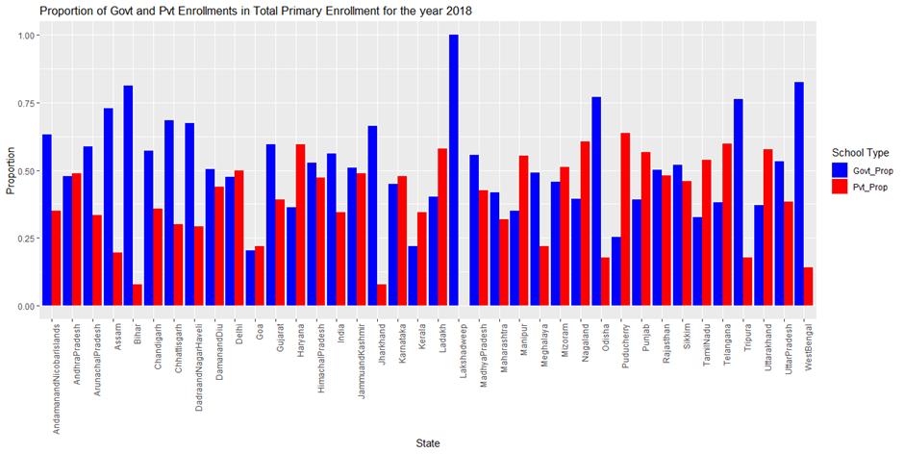


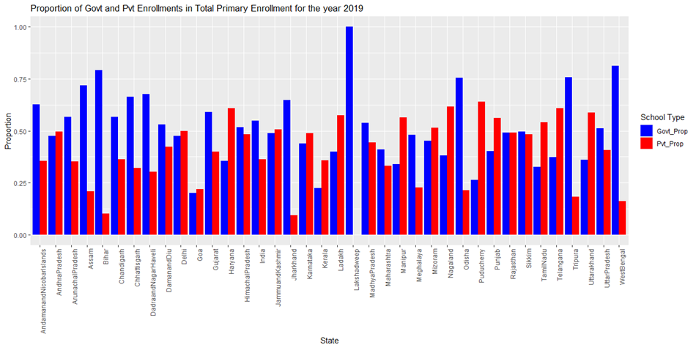

Figure 2.1: Grouped Bar Chart Showing Proportion of Government and Private Enrolments in Total Primary School Enrolment Across Indian States for the year 2018
Figure 2.2: Grouped Bar Chart Showing Proportion of Government and Private Enrolments in Total Primary School Enrolment Across Indian States for the year 2019

Slide 9
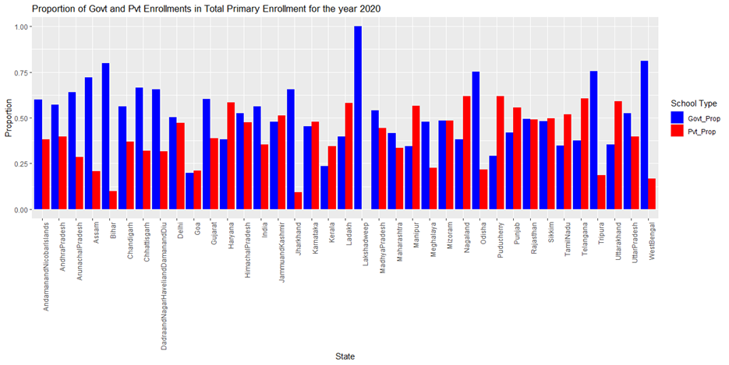

Figure 2.3: Grouped Bar Chart Showing Proportion of Government and Private Enrolments in Total Primary School Enrolment Across Indian States for the year 2020
Figure 2.4: Grouped Bar Chart Showing Proportion of Government and Private Enrolments in Total Primary School Enrolment Across Indian States for the year 2021

Slide 10
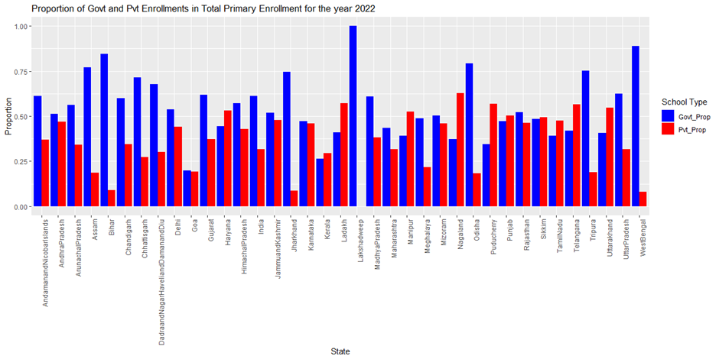
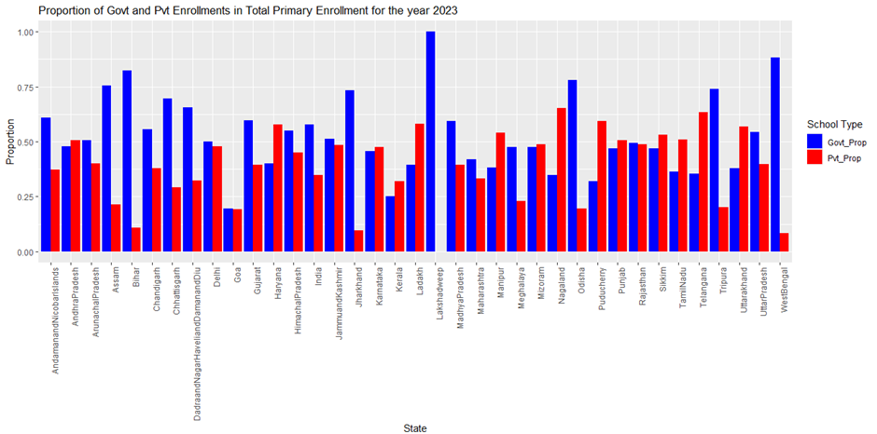
Figure 2.5: Grouped Bar Chart Showing Proportion of Government and Private Enrolments in Total Primary School Enrolment Across Indian States for the year 2022
Figure 2.6: Grouped Bar Chart Showing Proportion of Government and Private Enrolments in Total Primary School Enrolment Across Indian States for the year 2023

Slide 11
comments on figures 2.1-2.6
Lakshadweep shows zero private school enrollment, indicating the absence of private schools at the primary level in that state.
States like Assam, West Bengal, and Odisha have a high proportion of government school enrollments, with more than 75% of students enrolled in government schools.
States such as Punjab, Sikkim and Rajasthan show a more balanced distribution between government and private school enrollments.
Haryana, Ladakh and Uttarakhand exhibit relatively higher proportions of private school enrollment, indicating greater reliance on private institutions at the primary level.
Bihar and Jharkhand show very low private school enrollment, highlighting a strong dependence on government schooling.
The national average (India) also shows that government schools account for a higher proportion of total enrollments than private schools at the primary level.

Slide 12
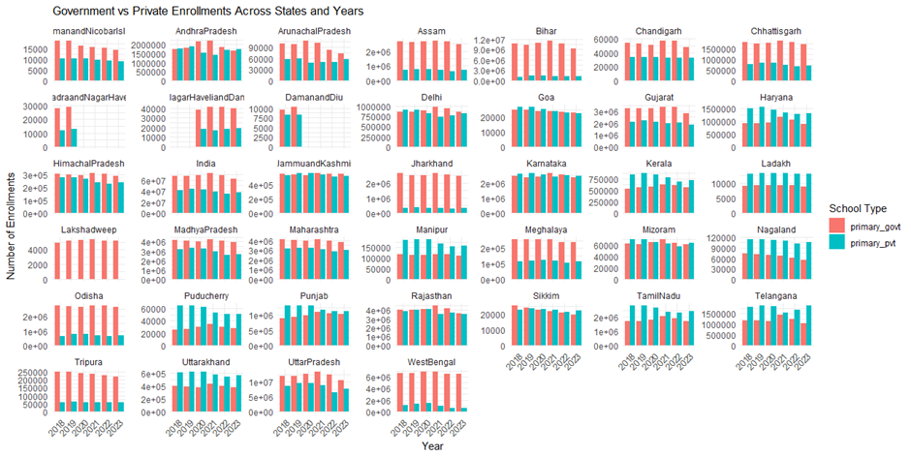
Comments on Figure 2.7:
· The gap between government and private enrolments varies across years, with certain states seeing a significant high private enrolments.
· The overall trend suggests that while government enrolments remain dominant in most states, private school enrolments have grown at a faster rate in many regions.
· Some states with high population density (such as Uttar Pradesh and Bihar) still show a strong presence of government enrolments.
Figure 2.7: Grouped Bar Chart Showing Government and Private Primary Enrolments Across Indian States from 2018 to 2023
Each panel represents a state/UT, displaying the number of enrolments in government and private primary schools over the years.

Slide 13
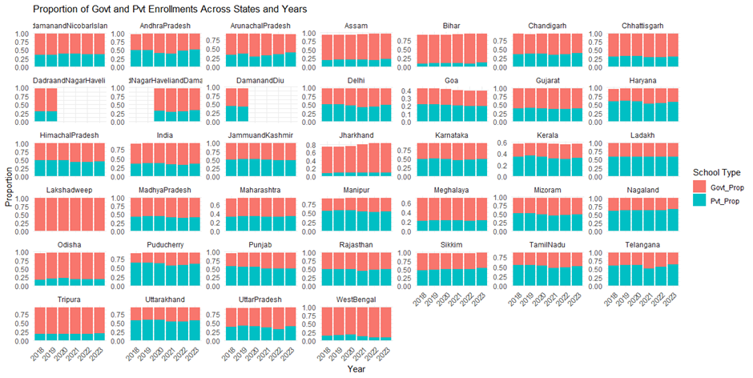
Comments on Figure 2.8:
·Certain states have a very high proportion of government school enrolments (e.g., Bihar, Jharkhand, Chhattisgarh, and Madhya Pradesh), likely due to government-led education schemes and lower affordability of private schools.
·States like Telengana, Tamilnadu, Ladakh, Uttarakhand show a high percentage of private enrolments, indicating better infrastructure and demand for private education.
Figure 2.8: Stacked Bar Chart Showing Proportion of Government and Private Enrolments in Primary Education Across Indian States (2018–2023)
Each panel represents a state/UT. For each year, the total primary enrolment is broken down into government and private school shares.
· The distribution highlights a regional disparity where eastern states have higher government enrolments, while southern and northern states lean more toward private enrolments.

Slide 14
3. DROPOUT TRENDS OVER TIME AND ACROSS GENDER
School dropout rates reflect the efficiency and equity of the education system. This section analyzes trends in primary-level dropout rates over the years and compares them between boys and girls, using statistical methods to assess the significance of the differences observed.
To statistically test whether there is a significant difference in dropouts between boys and girls we will be using a paired t-test.
Comparison of Dropouts Between Boys and Girls:
We are to test:
Null Hypothesis (H₀):H0: μ_d= 0 vs
Alternative Hypothesis (H₁):H₁: μ_d= ≠ 0
where μ_d = mean difference (boys - girls)
Test statistic:
T= d ̅/(sⅆ(d)∕√n)
Where;
d ̅= Mean of differences (boys’ dropout counts – girls’ dropout counts)
sⅆ(d) = Standard Deviation of the difference
n = Number of paired observations (223 here)

Slide 15
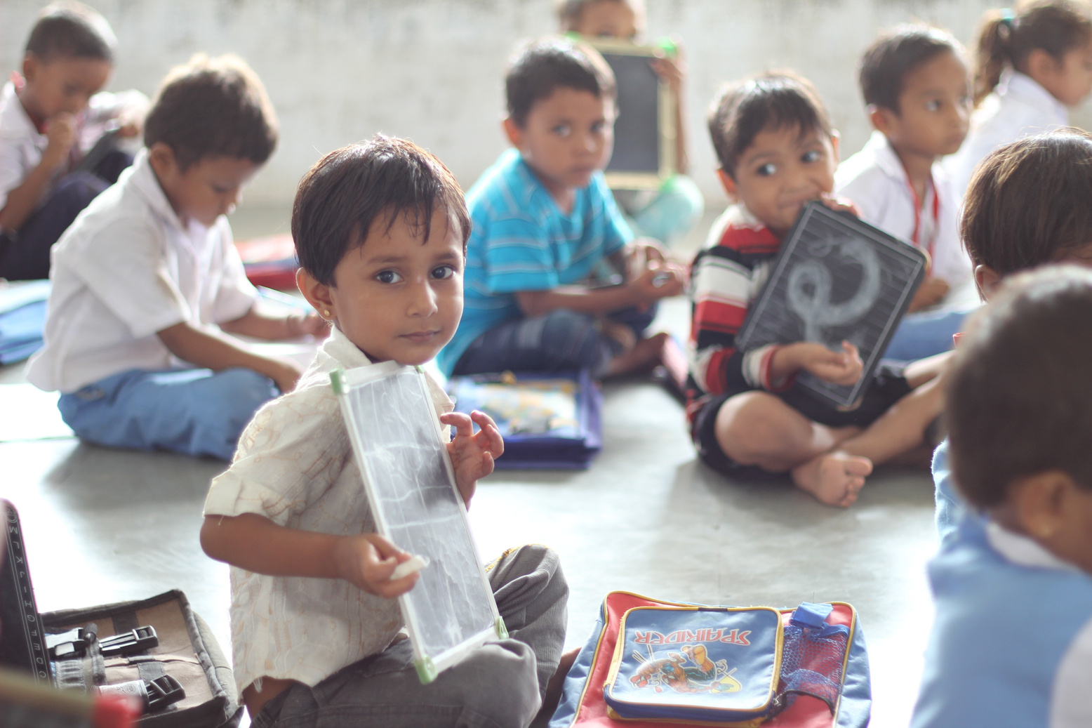
Critical Region:
Reject H0 iff |Tobs | > t_(n-1,α/2)
Where;
α = Level of significance (0.05) , n-1=222
R Output:
T = 3.7227
Degrees of freedom = 222
P-value = 0.0002499
95% Confidence Interval : 7645.506 24845.597
Sample Estimates: mean difference = 16245.55
The p-value (< 0.001) indicates a statistically significant difference in dropout counts between boys and girls. On an average, boys have 16,246 more dropouts than girls across the observations.
Also, T is coming out to be 3.7227 and Tcrit=1.970
Hence reject the null hypothesis.
There is strong statistical evidence that the dropout counts of boys and girls are not equal — the difference is statistically significant.

Slide 16
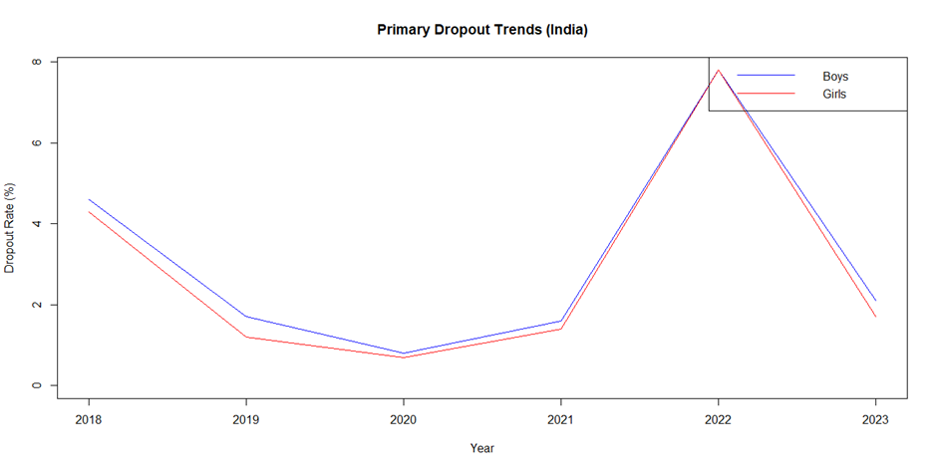
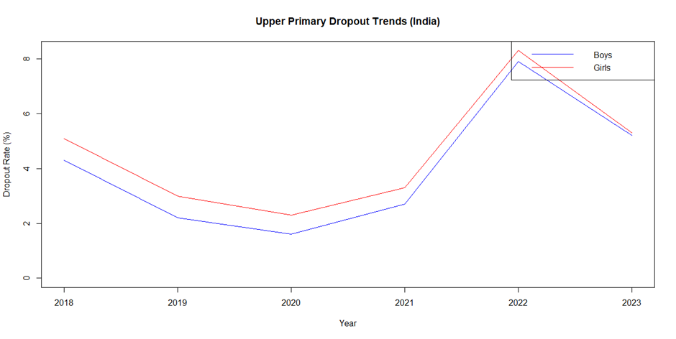
Now, let us look at some plots of dropout rates at different levels of Schools in India over the years:
Figure 3.1: Time series plot of Primary Dropouts in India over the years
Comments on Figure 3.1:
· Dropout Rate was decreasing from 2018 to 2020.
· After 2020 dropout rates started increasing.
· After 2021 there is a huge increase in dropout rates which overcomes at 2023. This may be due to the COVID-19 Pandemic.
Boys have higher dropout rates than of girls
Figure 3.2: Time series plot of Upper Primary dropout rates in India over the years
Comments on Figure 3.2:
· Almost similar Pattern with Primary dropouts.
· Girls have comparatively more dropouts than boys throughout every year.

Slide 17
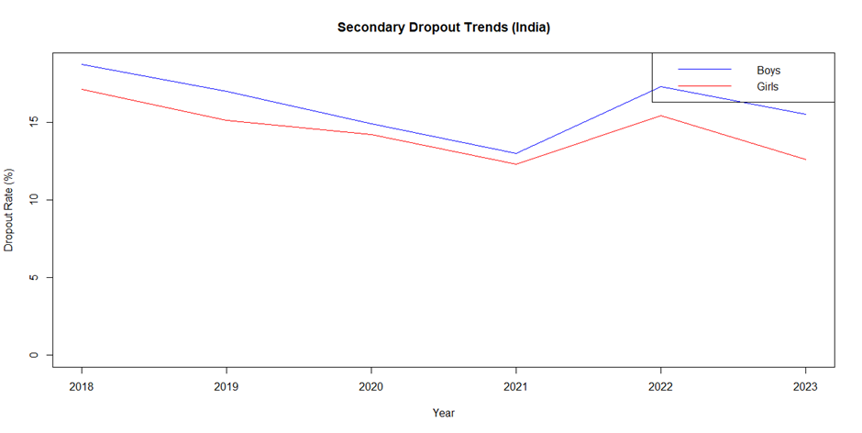


Figure 3.3: Time series plot of Secondary dropout rates in India over the years
Comments on Figure 3.3:
· Dropout rates are comparatively higher than Primary or Upper Primary level.
· Boys have higher dropout rates than girls throughout the whole time period.
· Dropout rate for both boys and girls was decreasing from 2018 to 2021
· Started increasing after 2021
· Again started stabilizing after 2022.

Slide 18
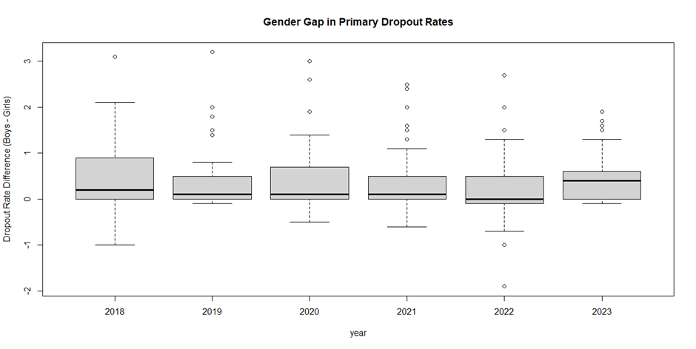
Now let us have a look on the plot of Gender Gaps at Primary Level:
Figure 3.4: Boxplot of Gender gaps(boys-girls) in Primary Dropout rates
Comments on Figure 3.4:
In every year from 2018 to 2023, the median dropout gap is slightly positive, indicating that boys consistently had marginally higher dropout rates than girls at the primary level.
The central line (median) remains quite close to 0 across the years, suggesting that while the gap favours boys dropping out more, the magnitude of the gap has not changed drastically over time.
All years show several positive outliers, which point to states or regions where boys dropped out at much higher rates than girls.
A few negative outliers, especially in 2022, indicate some instances where girls' dropout rates exceeded those of boys.
2018 and 2023 show wider interquartile ranges (IQRs), suggesting greater variation in gender gaps across states in those years.
The spread is relatively consistent in the middle years (2019–2021), indicating more uniformity during that period.
Despite the pandemic, the gender gap did not significantly widen or narrow, implying that both genders were similarly affected at the primary level in terms of dropout behaviour.

Slide 19
4. REGRESSION ANALYSIS OF STATE-WISE SCHOOL ENROLMENTS FOR THE YEAR 2023
To identify key factors influencing school enrolments across Indian states in 2023, a multiple linear regression was performed.
Dependent variable : Total school enrolment per state
Predictors:
Total population of the state (as a demographic indicator),
Unemployment rate (as a socio-economic measure),
Dropout rate at the secondary level (educational indicator),
Pupil-Teacher Ratio (PTR) at the secondary level (infrastructure-related factor).
The regression model is specified as follows:
Yi = β0 + β1 Pi + β2Ui + β3Di + β4Ti + ε_i ; i = 1 (1) n
Where,
Yi : Total enrolments due to the ith State
Pi : Total Population of the ith State
Ui : Unemployment rate of the ith State
Di : Dropout rate at secondary level of the ith State
Ti : Pupil-Teacher Ratio at the secondary level of the ith State
ε_i : Random error associated with Yi.
ε_i ~ N (0,σ^2) , i = 1 (1) n , n=37

Slide 20
Table 4.1: Summary of regression model using R:
 | Estimate | Std. error | t value | Pr ( > | t |)
Intercept | 3.900e+05 | 2.682e+05 | 1.454 | 0.1556
Population | 1.790e-01 | 4.355e-04 | 410.969 | <2e-16
Unemployment rates | 1.213e+03 | 8.707e+03 | 1.393 | 0.1733
Dropout rates | 3.109e+03 | 1.683e+04 | 0.185 | 0.8546
Pupil Teacher Ratio | -4.432e+04 | 1.671e+04 | -2.652 | 0.0123
From Table 4.1 and the mentioned results we conclude that,
1. A unit increase in population increases enrolment by 0.179 students (highly significant).
2. A 1 unit increase in pupil-teacher ratio (i.e., more students per teacher) results in a decrease of 44,320 enrolments, which is statistically significant.
3. The estimate of intercept is coming out to be 390000 i.e the baseline value when all predictors are 0.
4. Multiple R-squared = 0.9998
Indicates that 99.98% of the variability in enrolment is explained by the model — extremely high.
Residual Standard Error: 572500 on 32 degrees of freedom
Multiple R-squared: 0.9998, Adjusted R-squared: 0.9998
F-Statistic: 4.52e+04 on 4 and 32 DF
p-value: < 2.2e-16

Slide 21
TEST OF SIGNIFICANCE & MULTICOLINIEARITY AMONG THE PREDICTORS
Test of Significance of the Predictors:
So we are to test:
H0j: βj=0 vs H1j: βj ≠ 0 ∀j=1(1)4
The test statistic is given by:
Tj = β ̂_j / (sⅇ(β ̂_j)) ; ∀j=1(1)4
Critical region :
We reject H0j at α level of significance iff |𝑇𝑗 𝑜𝑏𝑠| > t (n-p-1), 𝛼/2
t (n-p-1), 𝛼/2 = 2.036933; for 𝛼 = 0.05
n= Total number of observation (37)
p= Number of predictors (4)
Table 4.2: Decision based on Critical Region and Test Statistic
In Table 4.1 “t value” are the values of 𝑇𝑗 𝑜𝑏𝑠.
PREDICTORS | DECISION
Population | Reject
Unemployment Rates | Accept
Dropout Rates | Accept
Pupil-Teacher Ratio | Reject
From table 4.1 & 4.2, we can conclude that,
1. Population has the strongest and most statistically significant positive impact on enrolment.
2. Pupil-teacher ratio (secondary) has a significant negative impact, indicating that poor teacher availability discourages enrolment.
3. Unemployment rates and dropout rates in secondary education are not statistically significant in this model

Slide 22


Variance Inflation factor(VIF):
what is vif???
Formula
Table 4.2: VIF values of the predictors
Predictor | VIF Value
Population | 1.074759
Unemployment Rates | 1.038708
Dropout Rates | 1.206055
Pupil-Teacher Ratio | 1.244534
From Table 4.2 we can say that,
All VIFs are close to 1, which means:
There is no multicollinearity issue among the predictor variables.
Each independent variable contributes unique information to the model.
The regression coefficients are stable and interpretable.
VIF measures how much the variance of a regression coefficient is inflated due to multicollinearity among the independent variables.
In simple terms:
It checks if the predictor variables are correlated with each other, which can distort the results of the regression.
Formula for VIF is given by:
VIFi = 1/(1-Ri^2 )
Where,
Ri^2 : The R-squared value from regressing ith variable on all the other predictor variables.

Slide 23

5. PUPIL TEACHER RATIO
The Pupil Teacher Ratio (PTR) is one of the major education indicators measuring the ratio of pupils to teachers
PTR= (Total Number of Students enrolled)/(Total Number of Teachers)
Table 5.1: PTR summarization of different school levels
Summary | Primary | Upper Primary | Secondary | Higher Secondary
Minimum | 6.00 | 3.00 | 5.00 | 8.00
1st Quartile | 15.85 | 11.00 | 10.00 | 15.00
Median | 21.00 | 16.00 | 12.00 | 19.00
Mean | 21.25 | 16.05 | 15.34 | 22.86
3rd Quartile | 26.00 | 20.00 | 18.00 | 28.00
Maximum | 57.00 | 33.00 | 55.00 | 67.00
Observations from table 5.1:
· Higher Secondary is experiencing the most severe teacher shortage problems on average and at extremes.
· Secondary and Upper Primary have comparatively lower PTRs, which reflects improved teacher availability.
· The Primary level, although balanced at the median, has some schools with extremely high PTRs.

Slide 24
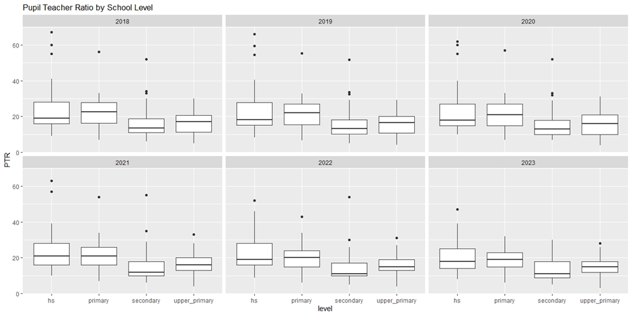
Figure 5.a: Boxplot of PTR for different school levels
over the years
Comments on Figure 5.A
Primary and HS levels consistently show higher median PTRs across all years, indicating relatively larger class sizes or fewer teachers per student.
Secondary and Upper Primary levels have comparatively lower median PTRs, suggesting better teacher availability.
There is a presence of outliers across all levels and years, especially at the HS and primary levels, indicating extreme cases with very high PTRs.
Overall, median PTR values remain fairly stable over the years, with no drastic shifts, though a slight decrease is visible in the higher levels from 2020 onwards.
The spread (IQR) is larger in HS and primary, indicating more variation in teacher distribution at those levels.

Slide 25
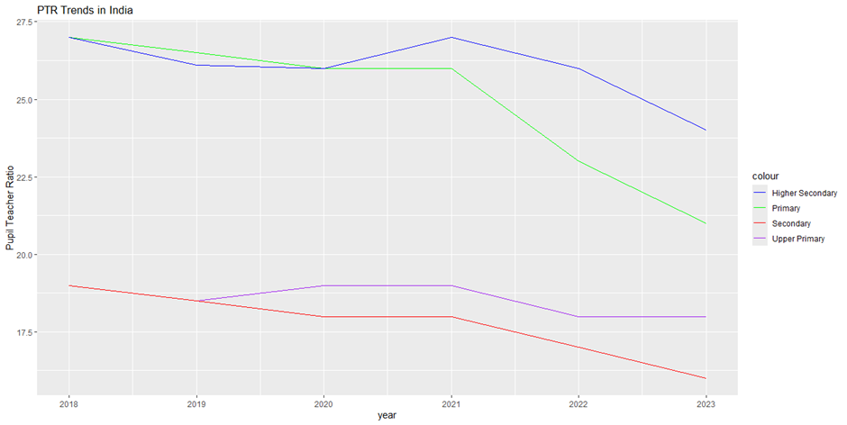
Figure 5.B: PTR trends in India over the years (2018-2023)
Comments on Figure 5.B:
Primary Level (Green Line):
· In the beginning close to 27 in 2018, a steady fall up to 2021, then a steep decline from 2021 to 2023.This may indicate recent targeted recruitment or reallocation of teachers at primary schools.
· 2023 PTR for primary is approximately 21, a notable improvement.
Higher Secondary (Blue Line):
· Begins near 27 in 2018, remains fairly level up to 2020, peaks in 2021, and then falls in 2022–2023.
· The 2021 peak might be caused by policy changes or short-term teacher deficiencies.
· Decreases by 25 around 2023, which is still high relative to other levels.
Secondary Level (Red Line):
· The most steady and smooth falling trend from ~19 in 2018 to ~16 in 2023.This indicates consistent improvement in the recruitment of teachers or more equitable
distribution over time.
Upper Primary (Purple Line):
· Varies somewhat; presents a slight peak around 2020–2021, then falling. The trend is weaker but concludes positively, as is the case at the secondary level.
Overall Decline: Across all levels of education, PTR is steadily declining, indicating improvement in teacher availability per student over the years.

Slide 26


Correlation Matrix:
Comments on Table 8.2:
· Primary & Secondary (0.81): High positive correlation — places with high PTR in primary are likely to have high PTR in secondary.
· Primary & Upper Primary (0.75): High positive correlation — PTR tendencies are much the same for the two levels.
· Primary & Higher Secondary (0.61): Moderate correlation — there is some correlation, but weaker.
· Secondary & Higher Secondary (0.75): High correlation — probably because of similar policy or staffing factors at these upper levels.
· Upper Primary & Secondary (0.66): Moderate to high correlation.
· Upper Primary & Higher Secondary (0.48): Lowest correlation — indicating different dynamics operating.
Total insight: PTRs across various school levels tend to be positively related to each other, particularly between consecutive levels (e.g., primary and secondary), suggesting systemic factors influencing teacher availability across levels in similar terms.
The correlation matrix shows how closely the Pupil Teacher Ratios (PTR)
are related across different school levels.
Table 8.2: Correlation Matrix of PTR at different school levels
 | Primary | Upper Primary | Secondary | Higher Secondary
Primary | 1 | 0.7500614 | 0.8109576 | 0.6134052
Upper Primary | 0.7500614 | 1 | 0.6578350 | 0.4848897
Secondary | 0.8109576 | 0.6578350 | 1 | 0.7534017
Higher Secondary | 0.6134052 | 0.4848897 | 0.7534017 | 1

Slide 27
conclusion
Dropout rates have generally declined, but gender gaps still exist.
Government schools dominate enrolments, though some states prefer private.
PTR is highest at the higher secondary level, with some improvement over time
.
Statistical tests confirm significant patterns in dropout and enrolment data.
Visuals made trends in education indicators easy to interpret.
Findings highlight the need for targeted, gender-aware policies.

Slide 28

References
WEBSITE:
UNIFIED DISTRICT INFORMATION SYSTEM OF EDUCATION (UDISE+)
UNIQUE IDENTIFICATION AUTHORITY OF INDIA
STUDY IQ
WIKIPEDIA
BOOK:
·BASIC ECONOMETRICS, DAMODAR N. GUJARATI & DAWN C. PORTER
JOURNAL:
·JOURNAL BY BRITISH COUNCIL ON SCHOOL EDUCATION SYSTEM OF INDIA.
·STUDY ON EDUCATION SYSTEM IN INDIA BY MS. S. DIVYA, ANDAMAN COLLEGE

Slide 29
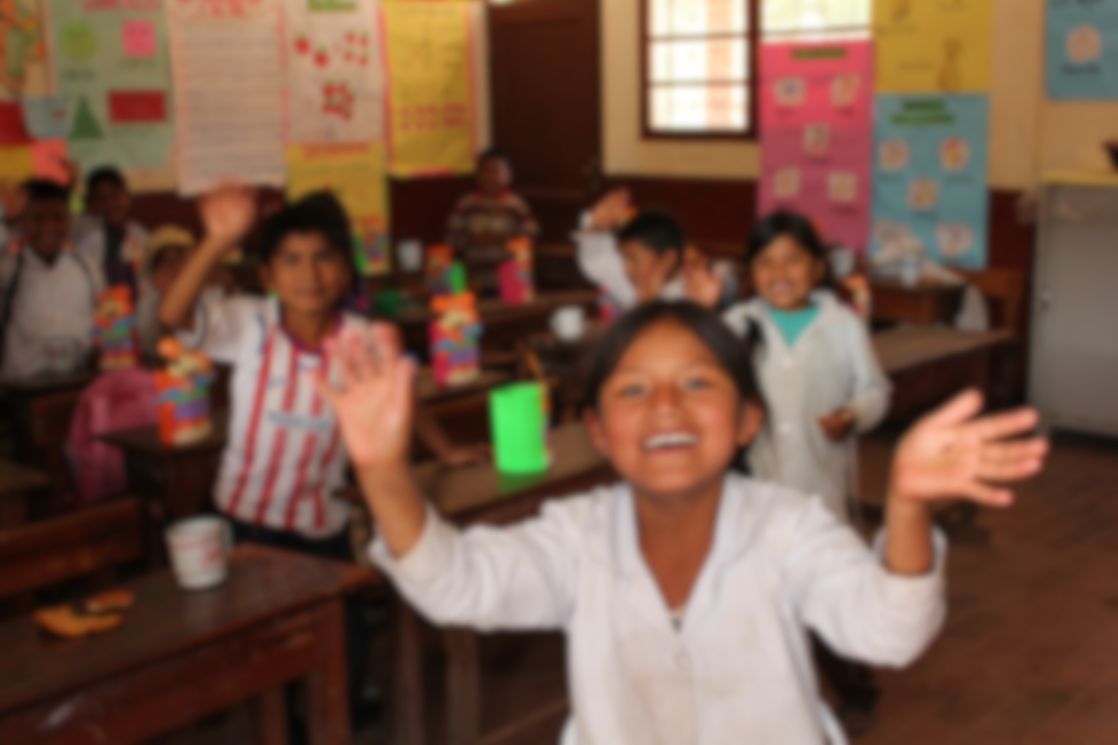
Thank you !

